Slide 1
Build First AI Agent Workflows
Using n8n

Slide 2
What is an AI Agent
An AI agent is an autonomous system designed to:
- Perceive its environment
- Process information intelligently
- Take actions to achieve specific goals

Slide 3
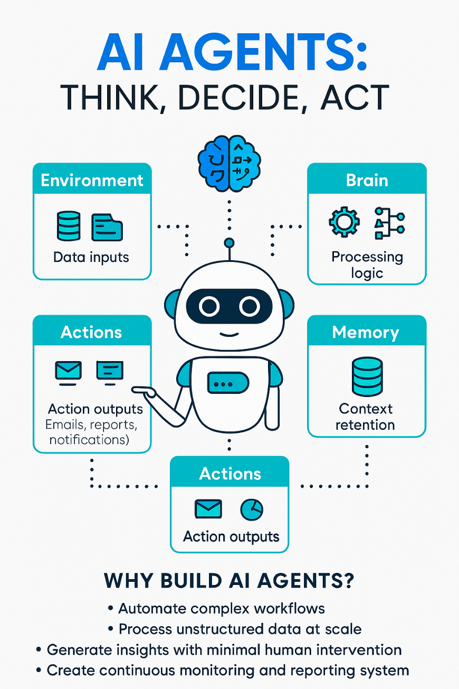
Why AI Agents
AI agents help organizations:
✅ Automate complex workflows across systems and teams
📄 Process unstructured data (text, images, logs) at scale
🔍 Generate insights with minimal human intervention
📊 Enable continuous monitoring and reporting for smarter decision-makin

Slide 4
Tools using to build AI Agent
Product Summary Agent
  N8n
    https://n8n.io/
    local installation:
      https://github.com/n8n-io/n8n
      https://docs.n8n.io/hosting/installation/server-setups/docker-compose/
  AirTable:
    https://airtable.com/
  Open AI Account:
    https://platform.openai.com
  Sample Dataset:
    https://www.kaggle.com/datasets/kartikeybartwal/product-price-estimation-dataset
  Gmail

